Slide 1
Java – Design Pattern

Slide 2
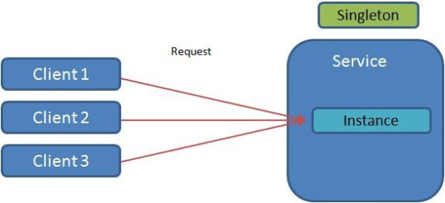
Singleton Pattern in Java
What is Singleton Design Pattern?
Singleton design pattern ensures a particular class has only one object instance for the lifetime of an application. That object is accessible via a global point of access and it is shared among all the required resources

Slide 3
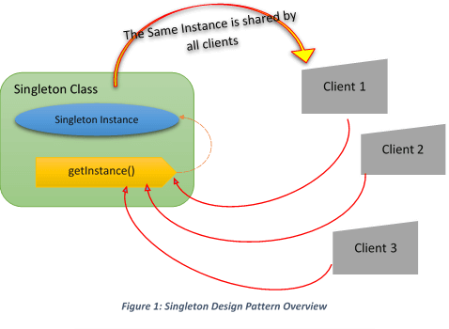
Singleton in Java

Slide 4
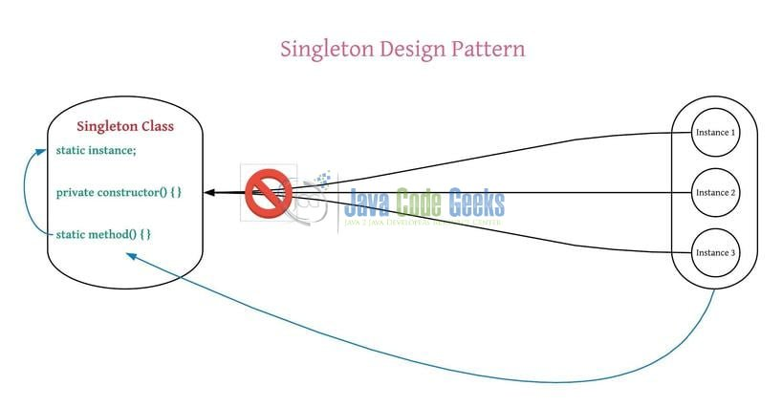
Singleton in Java

Slide 5
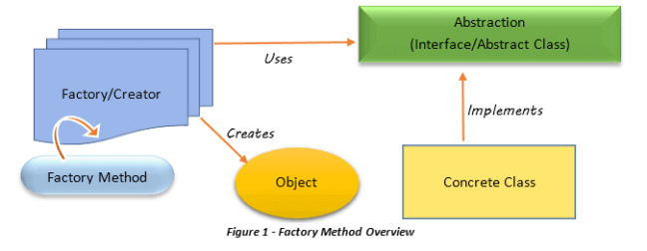
Factory Pattern in Java
“An interface for creating an object, but let subclasses decide which class to instantiate. Factory Method lets a class defer instantiation to subclasses”
In simpler words, object creation is handed over to a separate entity via an interface. This entity is called the factory, and it contains the object creation code with the help of an interface or an abstract class to create the suitable object from various class implementations. Only sub-classes are responsible and decide which class to instantiate at runtime.

Slide 6
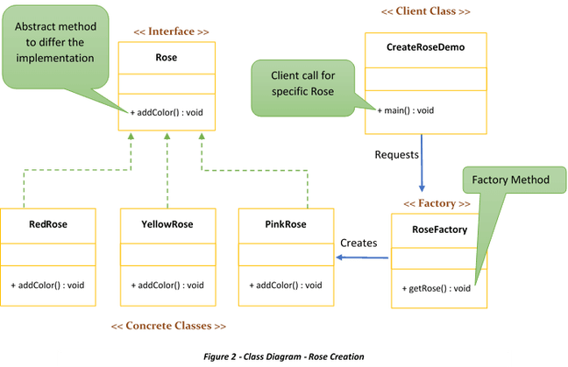
Factory Pattern in Java
The key concept of the Factory pattern is to abstract the way an object or a group of related objects are created and instantiated for a specific purpose.

Slide 7
Factory Pattern in Java
Class Diagram Components
Rose à Interface/Abstract Class:
Contains the factory method to use in the factory class. This method is shared by all the sub-classes to implement the unique functionality required by the system
RedRose(Yellow/Pink) àConcrete Class:
These concrete subclasses override the abstract methods included in the interface with their customized code
RoseFactory à Factory Class:
Uses the factory method to create the object instances. Factory method will be executed at this level to create unique instances depending on the request from the client
CreateRoseDemo à Client Class:
Request the specific behavior from the application. The client is not aware of how to create the object instead client knows when to create the object.

Slide 8
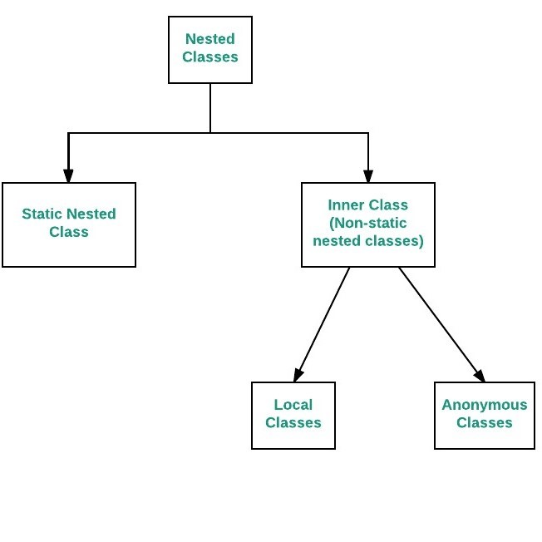
InnerClasses in Java
Static nested classes
As with class methods and variables, a static nested class is associated with its outer class. And like static class methods, a static nested class cannot refer directly to instance variables or methods defined in its enclosing class: it can use them only through an object reference.
Difference between static and inner(non-static nested) classes
Static nested classes do not directly have access to other members(non-static variables and methods) of the enclosing class because as it is static, it must access the non-static members of its enclosing class through an object. That is, it cannot refer to non-static members of its enclosing class directly. Because of this restriction, static nested classes are seldom used.
Non-static nested classes (inner classes) has access to all members(static and non-static variables and methods, including private) of its outer class and may refer to them directly in the same way that other non-static members of the outer class do.

Slide 9
Java 8 Features – Lambda Expressions
1) Definition
Java 8 Lambda Expressions can be defined as methods without names i.e anonymous functions. Like methods, they can have parameters, a body, a return type and possible list of exceptions that can be thrown. But unlike methods, neither they have names nor they are associated with any particular class.
Lambda Syntax
(Parameters) -> Expression
OR
(Parameters) -> { Statements }
Lambda syntax consist of three parts – list of parameters, an arrow mark and a body. The body of a lambda can be an expression or a set of statements. If it is set of statements, they must be enclosed within curly braces { }. Return type and possible list of exceptions that can be thrown are not explicitly mentioned in a lambda. They are implicitly applied.
3) Where To Use Lambda Expressions?
Lambda expressions are used where an instance of functional interface is expected. Functional interface is an interface which has only one abstract method. Functional interfaces can have any number of default methods. But, they must have only one abstract method. Comparator, Runnable And ActionListener are some examples of functional interfaces.

Slide 10
Java 8 Features – Lambda Expressions
4) How To Use Lambda Expressions?
Lambda expressions are used to implement functional interfaces. Before Java 8, anonymous inner classes are used to implement functional interfaces. Let’s explore this with some before Java 8 and after Java 8 code.
Before Java 8 : Implementation of Comparator interface using anonymous inner class
Comparator<Student> idComparator = new Comparator<Student>() {
@Override
public int compare(Student s1, Student s2) {
return s1.getID()-s2.getID();
}
};
After Java 8 : Implementation of Comaparator interface using lambda expressions
Comparator<Student> idComparator = (Student s1, Student s2) -> s1.getID()-s2.getID();
Before Java 8 : Implementation of Runnable interface using anonymous inner class
Runnable r = new Runnable() {
@Override
public void run() {
System.out.println("Runnable Implementation Using Anonymous Inner Class");
}
};
After Java 8 : Implementation of Runnable interface using lambda expressions
Runnable r = () -> System.out.println("Runnable Implementation Using Lambda Expressions");

Slide 11


